Slide 1
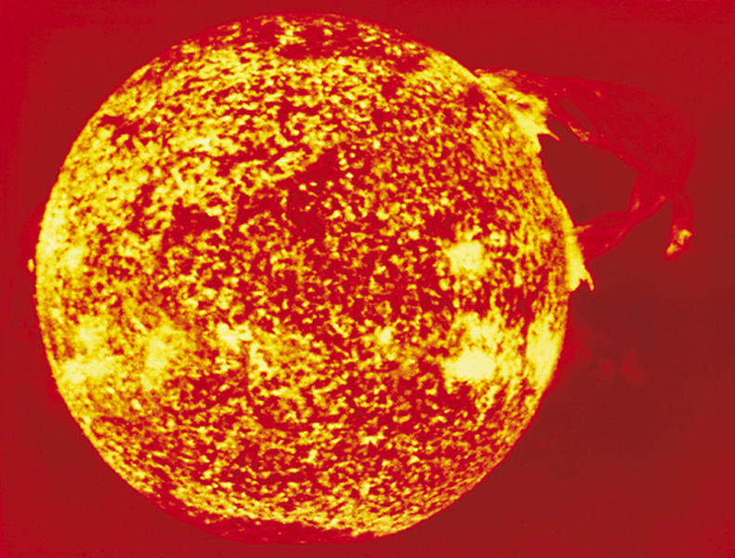
Chapter 26: Nuclear Chemistry
General Chemistry
Principles and Modern Applications
Petrucci • Harwood • Herring
8th Edition
Philip Dutton
University of Windsor, Canada
N9B 3P4
Prentice-Hall © 2002

Slide 2
Contents
26-1 The Phenomenon of Radioactivity
26-2 Naturally Occurring Radioactive Isotopes
26-3 Nuclear Reactions and Artificially Induced Radioactivity
26-4 Transuranium Elements
26-5 Rate of Radioactive Decay
26-6 Nuclear Stability
26-7 Nuclear Fission

Slide 3
Contents
26-8 Nuclear Fusion
26-9 Effect of Radiation on Matter
26-10 Applications of Radioisotopes
Focus On Radioactive Waste Disposal

Slide 4
26-1 The Phenomenon of Radioactivity
Alpha Particles, α:
  Nuclei of He atoms, ⁴He²⁺.
  Low penetrating power, stopped by a sheet of paper.
2
²³⁸U
→
²³⁴Th
+
⁴He²⁺
92
90
2
The sum of the mass numbers must be the same on both sides.
The sum of the atomic numbers must be the same on both sides

Slide 5
Beta Particles, β⁻
Electrons originating from the nuclei of atoms in a nuclear decay process.
Simplest process is the decay of a free neutron:
¹n → ¹p + ⁰β + ν
0
1
-1
²³⁴Th
→
²³⁴Pa
+
⁰β
90
91
-1

Slide 6
Positrons, β⁺
Simplest process is the decay of a free proton:
Commonly encountered in artificially produced radioactive nuclei of the lighter elements:
¹p → ¹n + ⁰β
1
0
+1
³⁰P
→
³⁰Si
+
⁰β
15
14
+1

Slide 7
Electron Capture and Gamma Rays
Electron capture achieves the same effect as positron emission.
²⁰²Ti
+
⁰β
→
²⁰¹Hg
→
²⁰¹Hg
‡
+ X-ray
81
-1
80
80
Gamma rays.
  Highly penetrating energetic photons.
²³⁸U
→
²³⁴Th
+
⁴He²⁺
92
90
2
²³⁴Th
→
²³⁴Th
+
γ
90
‡
90

Slide 8
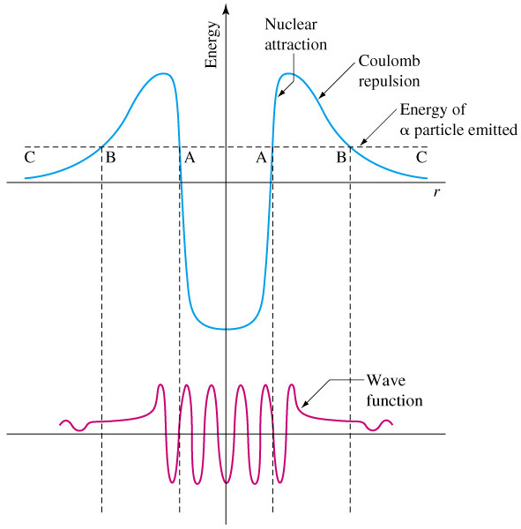
Tunneling Out of the Nucleus

Slide 9
26-2 Naturally Occurring Radioactive Isotopes
²³⁸U
→
²³⁴Th
+
⁴He²⁺
92
90
2
²³⁴Th
→
²³⁴Pa
+
⁰β
90
91
-1
²³⁴Pa
→
²³⁴U
+
⁰β
91
92
-1
Daughter nuclides are new nuclides
produced by radioactive decay.

Slide 10
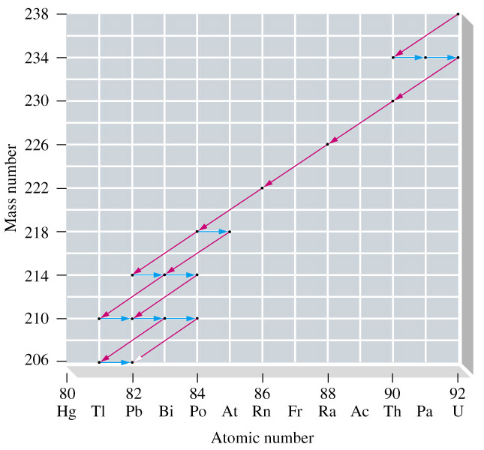
Radioactive Decay Series for ²³⁸U
92

Slide 11
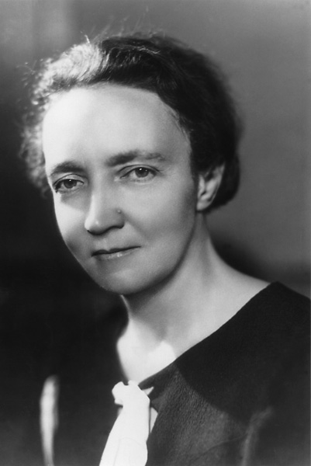
Marie Sklodowska Curie
Shared Nobel Prize 1903
Radiation Phenomenon
Nobel Prize 1911
Discovery of Po and Ra.

Slide 12
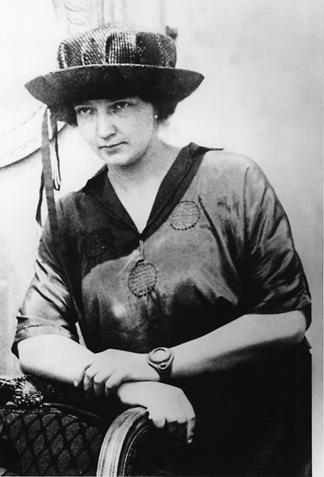
26-3 Nuclear Reactions and
Artificially Induced Radioactivity
Rutherford 1919.
¹⁴N
+
⁴He
→
¹⁷O
+
¹H
7
2
8
1
Irene Joliot-Curie.
²⁴Al
+
⁴He
→
³⁰P
+
¹n
13
2
15
0
15
14
+1
³⁰P
→
³⁰Si
+
⁰β
Shared Nobel Prize 1938

Slide 13
26-4 Transuranium Elements
U
+
n
→
U
+
γ
²³⁸
¹
²³⁹
92
0
92
²³⁹
U
→
²³⁹
Np
+
⁰
β
92
93
⁻¹
Cf
+
N
→
U
+
4
n
²⁴⁹
¹⁵
²⁶⁰
¹
98
7
105
0

Slide 14
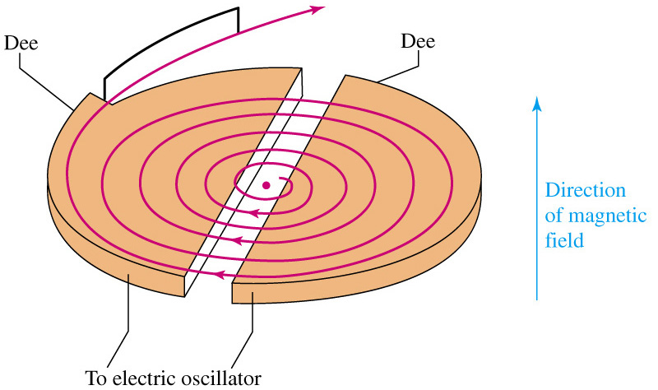
Cyclotron

Slide 15
26-5 Rate of Radioactive Decay
The rate of disintegration of a radioactive material – called the activity, A, or the decay rate – is directly proportional to the number of atoms present.
N_{t}
ln
= -λt
N₀

Slide 16
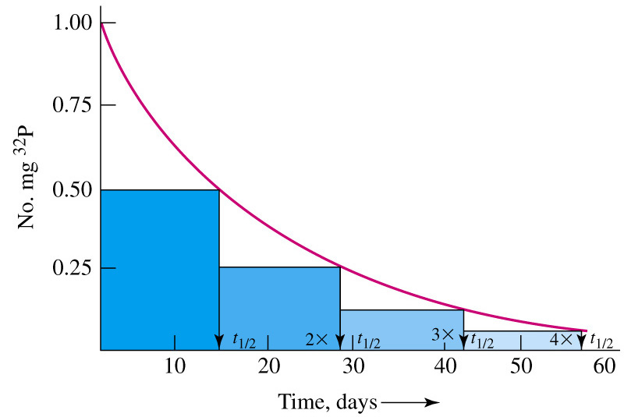
Radioactive Decay of a Hypothetical ³¹P Sample

Slide 17
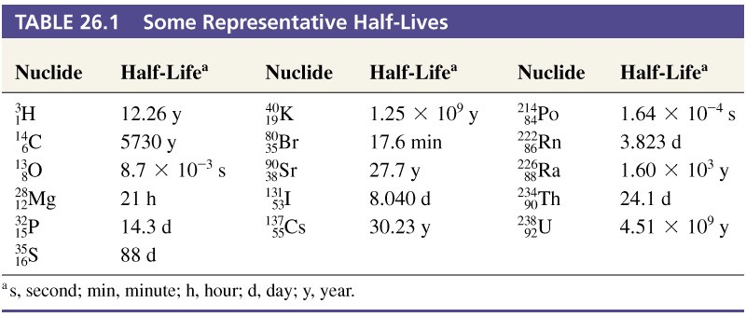
Table 26.1 Some Representative Half-Lives

Slide 18
Radiocarbon Dating
In the upper atmosphere ¹⁴C forms at a constant rate:
N
+
n
→
C
+
H
¹⁴
¹
¹⁴
¹
7
0
6
1
¹⁴
C
→
¹⁴
N
+
β
T_{½} = 5730 Years
6
7
⁰
-1
Live organisms maintain ¹⁴C/¹³C at equilibrium.
Upon death, no more ¹⁴C is taken up and ratio changes.
Measure ratio and determine time since death.

Slide 19
Mineral Dating
Ratio of ²⁰⁶Pb to ²³⁸U gives an estimates of the age of rocks. The overall decay process (14 steps) is:
The oldest known terrestrial mineral is about
4.5 billion years old.
  This is the time since that mineral solidified.
²³⁸U
→
²⁰⁶Pb
+ 8
⁴He²⁺
+ 6
⁰β
92
82
2
-1

Slide 20
26-6 Energetics of Nuclear Reactions
E = mc²
All energy changes are accompanied by mass changes (m).
  In chemical reactions ΔE is too small to notice m.
  In nuclear reactions ΔE is large enough to see m.
1 MeV = 1.602210⁻¹³ J
If m = 1.0 u then ΔE =1.492410⁻¹⁰ J or 931.5 MeV

Slide 21
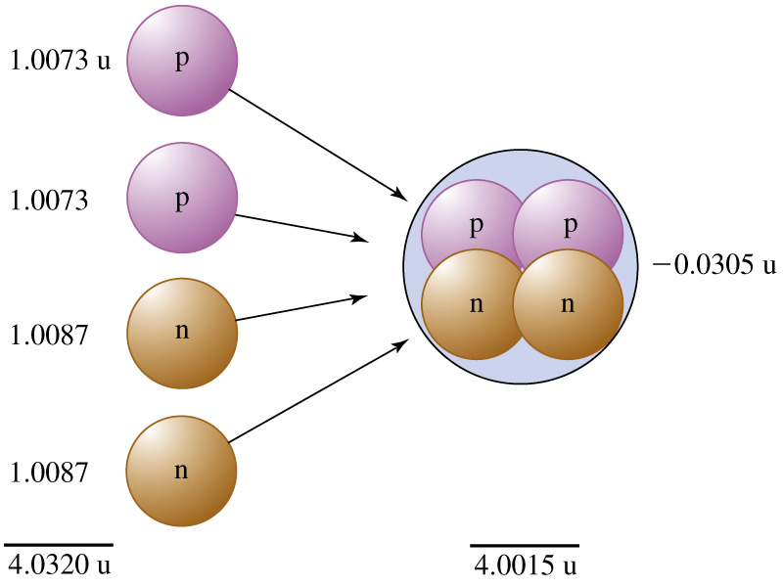
Nuclear Binding Energy

Slide 22
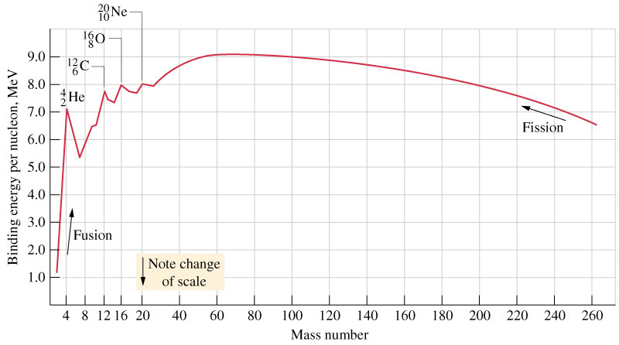
Average Binding Energy as a Function of Atomic Number

Slide 23
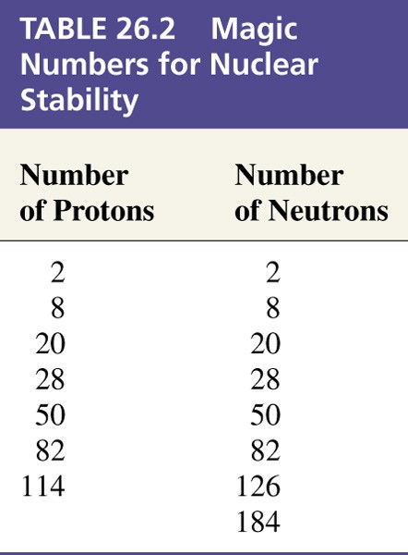
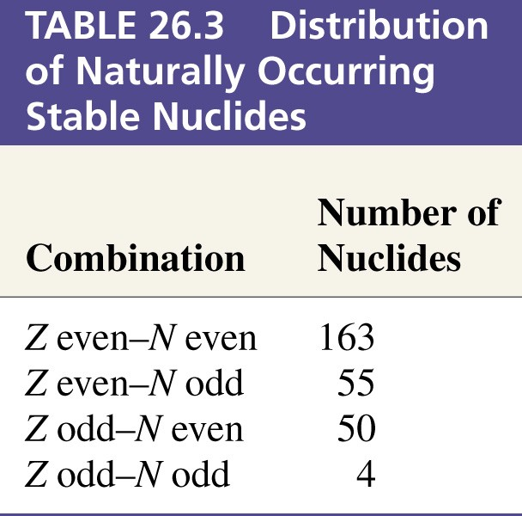
26-7 Nuclear Stability
Shell Theory

Slide 24
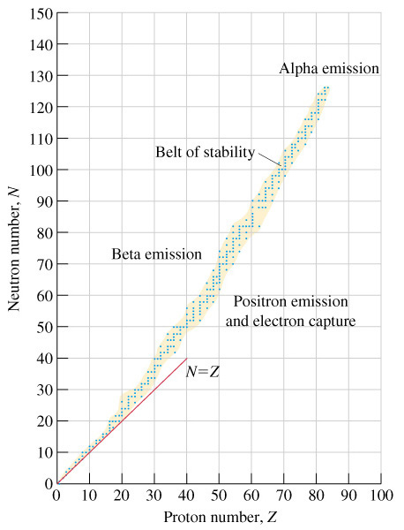
Neutron-to-Proton Ratio

Slide 25
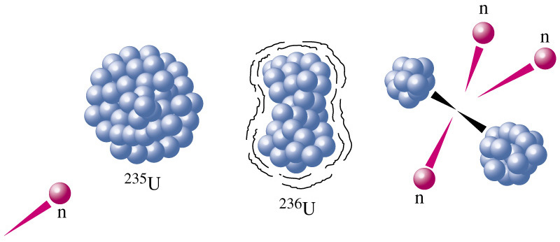
26-8 Nuclear Fission

Slide 26
Nuclear Fission
Enrico Fermi 1934.
  In a search for transuranium elements U was bombarded with neutrons.
  β emission was observed from the resultant material.
Otto Hahn, Lise Meitner and Fritz Stassman 1938.
  Z not greater than 92.
  Ra, Ac, Th and Pa were found.
  The atom had been split.

Slide 27
Nuclear Fission
²³⁵U
+ 1
¹n
→
Fission fragments
+ 3
¹n
+ 3.2010⁻¹¹ J
92
0
0
Energy released is 8.210⁷ kJ/g U.
This is equivalent to the energy from burning 3 tons of coal

Slide 28
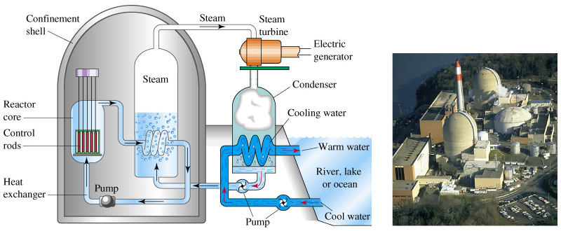
Nuclear Reactors

Slide 29
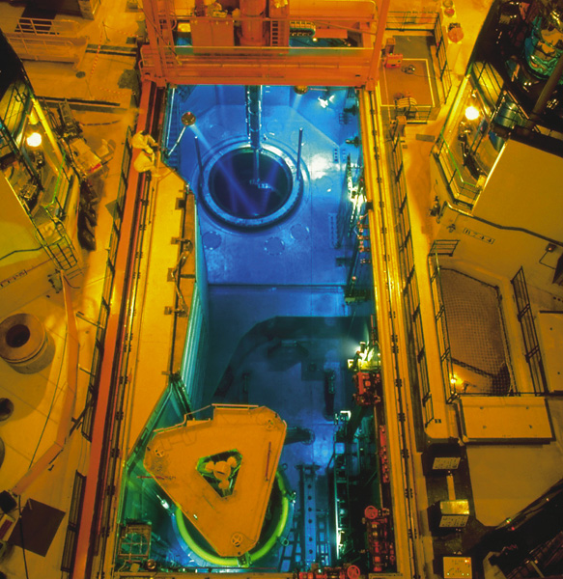
The Core of a Reactor

Slide 30
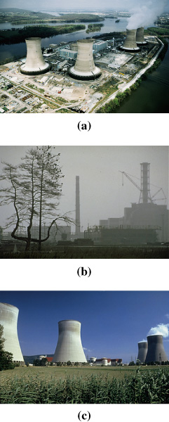
Nuclear “Accidents”
Three Mile Island – partial meltdown due to lost coolant.
Chernobyl – Fault of operators and
testing safety equipment
too close to the limit.
France – safe operation provides 2/3 of power requirements for the country.

Slide 31
Breeder Reactors
Fertile reactors produce other fissile material.
²³⁸U
+ 1
¹
n
→
²³⁹U
92
0
92
²³⁹U
→
²³⁹Np
+
⁰
β
92
93
-1
²³⁹Np
→
²³⁹Pu
+
⁰
β
93
94
-1

Slide 32
Disadvantages of Breeder Reactors
Liquid-metal-cooled fast breeder reactor (LMFBR).
  Sodium becomes highly radioactive in the reactor.
  Heat and neutron production are high, so materials deteriorate more rapidly.
  Radioactive waste and plutonium recovery.
    Plutonium is highly poisonous and has a long half life (24,000 years).

Slide 33
26-9 Nuclear Fusion
Fusion produces the energy of the sun.
Most promising process on earth would be:
Plasma temperatures over 40,000,000 K to initiate a self-sustaining reaction (we can’t do this yet).
Lithium is used to provide tritium and also act as the heat transfer material – handling problems.
Limitless power once we start it up.
²
H
+
³
H
→
⁴
He
+
¹
n
1
1
2
0

Slide 34
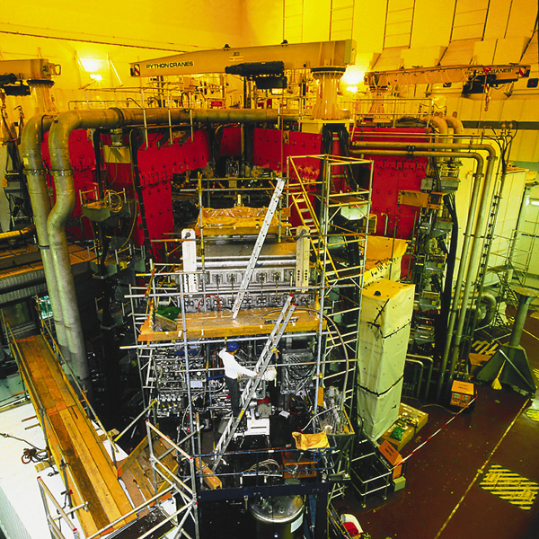
Tokomak

Slide 35
26-10 Effect of Radiation on Matter
Ionizing radiation.
  Power described in terms of the number of
  ion pairs per cm of path through a material.
  P_{α} > P_{β} > P_{γ}
  Primary electrons ionized by the radioactive particle may have sufficient energy to produce secondary ionization.

Slide 36
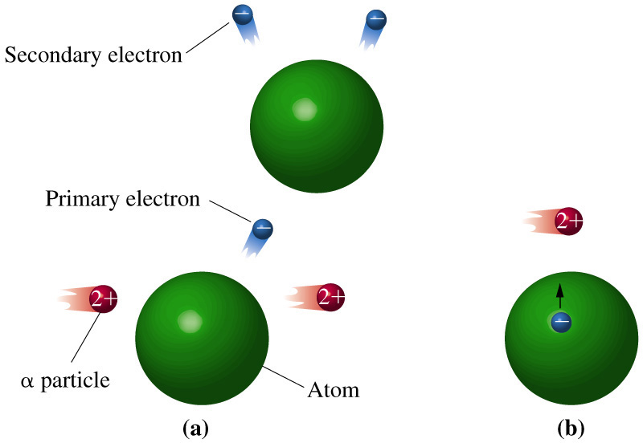
Ionizing Radiation

Slide 37
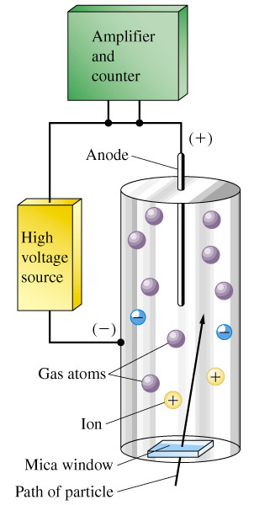
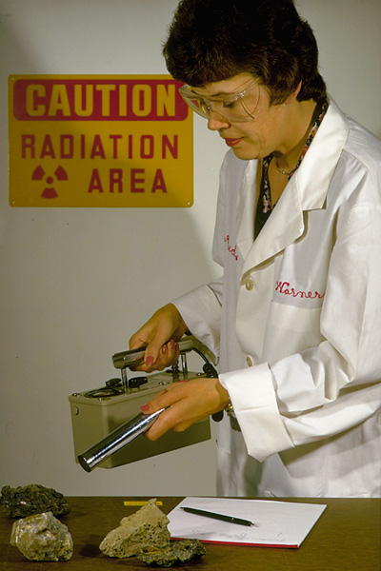
Geiger-Müller Counter

Slide 38
Radiation Dosage
1 rad (radiation absorbed dose) = 0.001 J/kg matter
1 rem (radiation equivalent for man) = radQ
Q = relative biological effectiveness

Slide 39
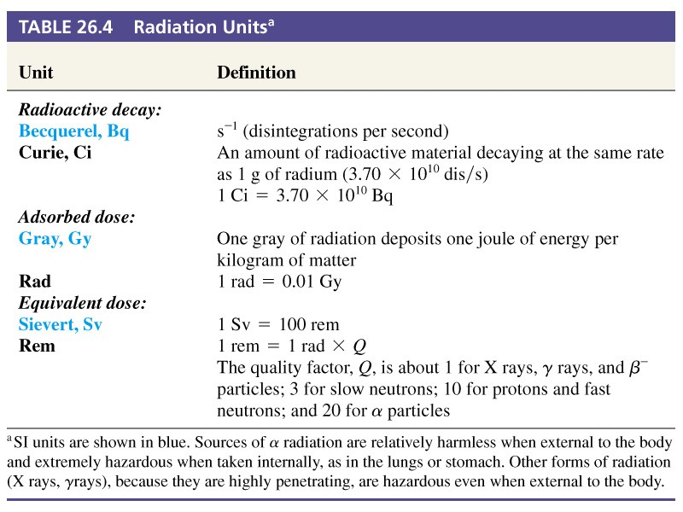
Table 26.4 Radiation Units

Slide 40
26-11 Applications of Radioisotopes
Cancer therapy.
  In low doses, ionizing radiation induces cancer.
  In high doses it destroys cells.
    Cancer cells are dividing quickly and are more susceptible to ionizing radiation than normal cells.
    The same is true of chemotherapeutic approaches.

Slide 41
Radioactive Tracers
Tag molecules or metals with radioactive tags and monitor the location of the radioactivity with time.
  Feed plants radioactive phosphorus.
  Incorporate radioactive atoms into catalysts in industry to monitor where the catalyst is lost to (and how to recover it or clean up the effluent).
  Iodine tracers used to monitor thyroid activity.

Slide 42
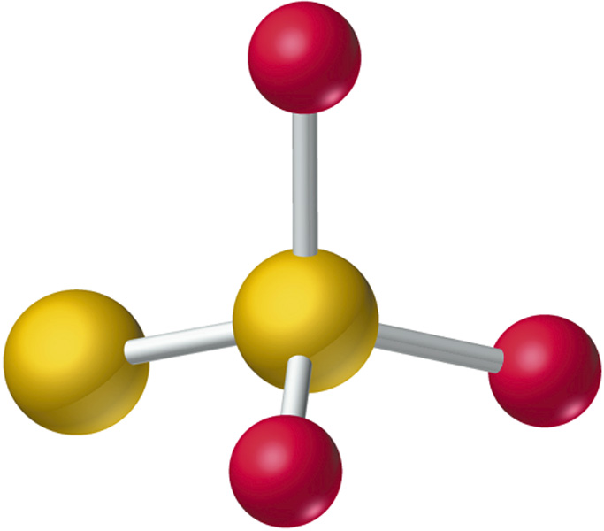
Structures and Mechanisms
Radiolabeled (or even simply mass labeled) atoms can be incorporated into molecules.
The exact location of those atoms can provide insight into the chemical mechanism of the reaction.

Slide 43
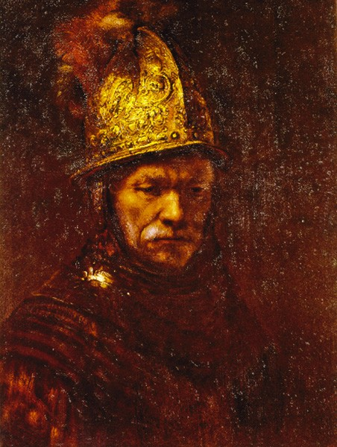
Analytical Chemistry
Precipitate ions and weigh them to get a mass of material.
  Incorporate radioactive ions in the precipitating mixture and simply measure the radioactivity.
Neutron activation analysis.
  Induce radioactivity with neutron bombardment.
  Measure in trace quantities, down to ppb or less.
  Non-destructive and any state of matter can be probed.

Slide 44
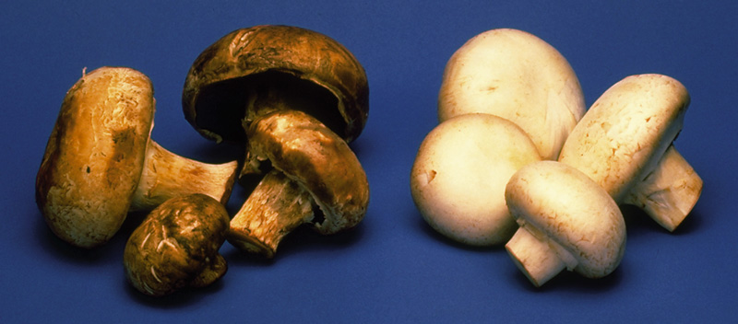
Radiation Processing

Slide 45
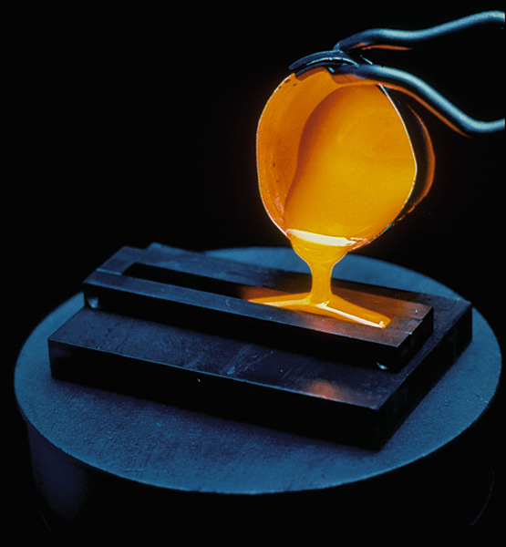
Focus On Radioactive Waste Disposal

Slide 46
Focus On Radioactive Waste Disposal
Low level waste.
  Gloves, protective clothing, waste solutions.
    Short half lives.
    After 300 years these materials will no longer be radioactive.
High level waste.
  Long half lives.
    Pu, 24,000 years and extremely toxic.
    Reprocessing is possible but hazardous.
      Recovered Pu is of weapons grade.

Slide 47
Chapter 26 Questions
Develop problem solving skills and base your strategy not on solutions to specific problems but on understanding.
Choose a variety of problems from the text as examples.
Practice good techniques and get coaching from people who have been here before.

